Slide 1
GRADE 7 ACCELERATED · UNIT 4
Solving Problems with Rational Numbers
Six lessons in teaching order · the next slide jumps to each one
Grade 7 Accelerated · Unit 4 — Solving Problems with Rational Numbers
1

Slide 2
Contents
Click a lesson to jump to it. Each lesson numbers its slides from 1, as its Teacher Edition does.
4.01
Adding and Subtracting in Scientific Notation
slide 3
4.02–03
Multiplying and Dividing in Scientific Notation
slide 37
4.04
Real-World Problems and Significant Digits
slide 71
4.05
Evaluating Expressions with Radicals
slide 105
4.06
Order of Operations with Radicals
slide 139
4.07–08
Real-World Order of Operations
slide 173
Grade 7 Accelerated · Unit 4 — Solving Problems with Rational Numbers
2

Slide 3
GRADE 7 ACCELERATED · UNIT 4 · LESSON 1
Adding and Subtracting in Scientific Notation
MA.8.NSO.1.5
I can add and subtract two numbers written in scientific notation, and write the answer in scientific notation.
Last unit you learned to write numbers in scientific notation.
Today you put two of them together — and the powers of ten have to match first.
Grade 7 Accelerated · Unit 4 · Lesson 1 — Adding and Subtracting in Scientific Notation
1

Slide 4


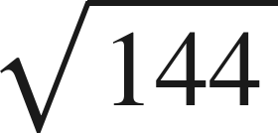

Warm-Up
On your own. Four minutes. No notes.
1. Write 0.00062 in scientific notation.
2. How many times larger is
than
?
3. Find the value:
4. Find the sum:
Grade 7 Accelerated · Unit 4 · Lesson 1 — Adding and Subtracting in Scientific Notation
2

Slide 5
Warm-Up
Answers.
1. Write 0.00062 in scientific notation.
6.2 × 10⁻⁴
2. How many times larger is
than
?
4,000
3. Find the value:
12
4. Find the sum:
1.69
Grade 7 Accelerated · Unit 4 · Lesson 1 — Adding and Subtracting in Scientific Notation
3

Slide 6
Notes
Copy the table.
I. A power of ten is a place value
10³ | 10⁴ | 10⁵ | 10⁶
thousands | ten thousands | hundred thousands | millions
Two numbers can be added only when they carry the same power of ten.
Grade 7 Accelerated · Unit 4 · Lesson 1 — Adding and Subtracting in Scientific Notation
4

Slide 7
Notes
II. Same power: add or subtract the coefficients
Add or subtract the coefficients. The power of ten does not change.
Then check the coefficient: if it is not between 1 and 10, the answer is not finished.
Grade 7 Accelerated · Unit 4 · Lesson 1 — Adding and Subtracting in Scientific Notation
5

Slide 8
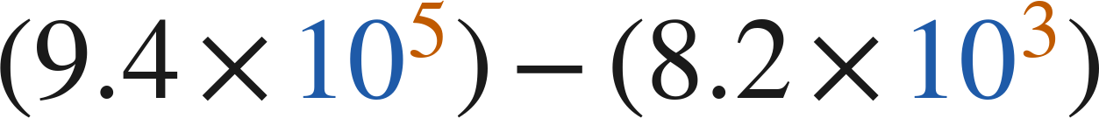

Notes
III. Different powers: rewrite one of them first
, never
Rewrite one number so both carry the same power of ten, then add or subtract the coefficients.
Exponent up one, decimal point one place left. The value does not move.
Grade 7 Accelerated · Unit 4 · Lesson 1 — Adding and Subtracting in Scientific Notation
6

Slide 9
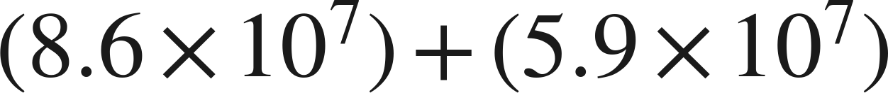
Example 1
Same power, and the answer is not finished.
Add. Write the answer in scientific notation.
Grade 7 Accelerated · Unit 4 · Lesson 1 — Adding and Subtracting in Scientific Notation
7

Slide 10
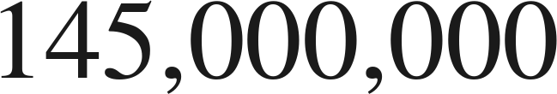
Example 1
Worked.
same power: add the coefficients
14.5 is not less than 10: point one place left, exponent up one
check in standard form
Answer: 1.45 × 10⁸
Grade 7 Accelerated · Unit 4 · Lesson 1 — Adding and Subtracting in Scientific Notation
8

Slide 11
Your Turn
Same steps, your numbers. Boards up when done.
Grade 7 Accelerated · Unit 4 · Lesson 1 — Adding and Subtracting in Scientific Notation
9

Slide 12
Your Turn
Answer.
12.3 × 10⁻³, then repair
Answer: 1.23 × 10⁻²
Grade 7 Accelerated · Unit 4 · Lesson 1 — Adding and Subtracting in Scientific Notation
10

Slide 13
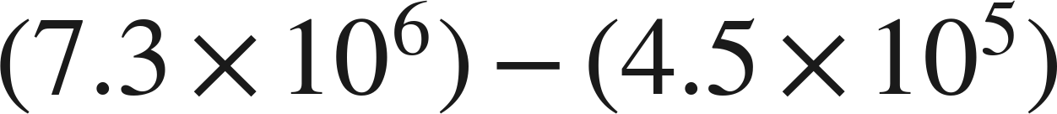
Example 2
Different powers, and a subtraction.
Subtract. Write the answer in scientific notation.
Grade 7 Accelerated · Unit 4 · Lesson 1 — Adding and Subtracting in Scientific Notation
11

Slide 14

Example 2
Worked.
rewrite over 10⁶
same power: subtract the coefficients
check in standard form
Answer: 6.85 × 10⁶
Grade 7 Accelerated · Unit 4 · Lesson 1 — Adding and Subtracting in Scientific Notation
12

Slide 15
Your Turn
Same steps, your numbers. Boards up when done.
Grade 7 Accelerated · Unit 4 · Lesson 1 — Adding and Subtracting in Scientific Notation
13

Slide 16
Your Turn
Answer.
0.09 × 10⁻⁴ comes off 5.6 × 10⁻⁴
Answer: 5.51 × 10⁻⁴
Grade 7 Accelerated · Unit 4 · Lesson 1 — Adding and Subtracting in Scientific Notation
14

Slide 17
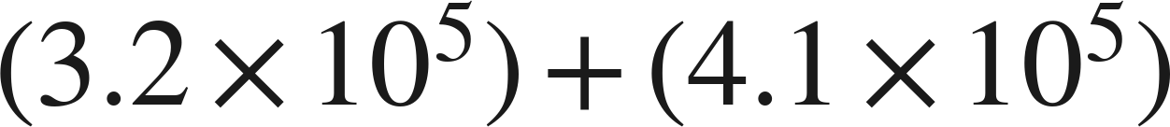
Whiteboards · Question 1 of 9
Boards up on three.
Answer it.
Same power.
Grade 7 Accelerated · Unit 4 · Lesson 1 — Adding and Subtracting in Scientific Notation
15

Slide 18
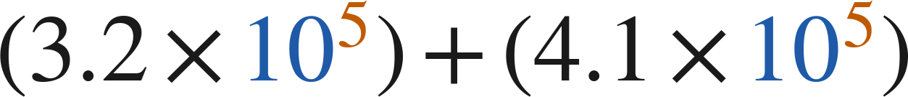
Whiteboards · Question 1 of 9
Answer.
add the coefficients
Answer: 7.3 × 10⁵
Grade 7 Accelerated · Unit 4 · Lesson 1 — Adding and Subtracting in Scientific Notation
16

Slide 19


Whiteboards · Question 2 of 9
Boards up on three.
A stadium sold
tickets on Friday
and
on Saturday. Each ticket cost 38 dollars.
How many tickets were sold on the two days?
Answer it.
Grade 7 Accelerated · Unit 4 · Lesson 1 — Adding and Subtracting in Scientific Notation
17

Slide 20


Whiteboards · Question 2 of 9
Answer.
A stadium sold
tickets on Friday
and
on Saturday. Each ticket cost 38 dollars.
How many tickets were sold on the two days?
4.2 + 3.5
Answer: 7.7 × 10⁴
Grade 7 Accelerated · Unit 4 · Lesson 1 — Adding and Subtracting in Scientific Notation
18

Slide 21
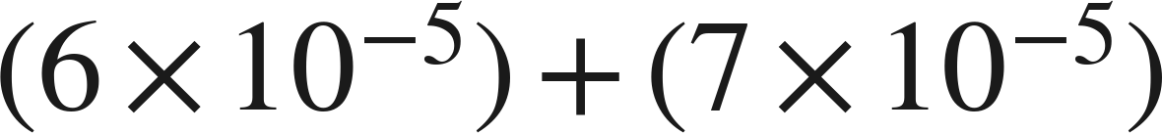
Whiteboards · Question 3 of 9
Boards up on three.
Answer it.
Finish the answer.
Grade 7 Accelerated · Unit 4 · Lesson 1 — Adding and Subtracting in Scientific Notation
19

Slide 22
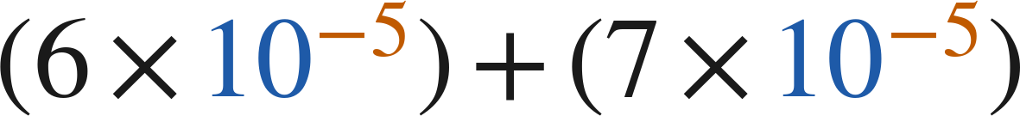
Whiteboards · Question 3 of 9
Answer.
13 × 10⁻⁵ is not finished
Answer: 1.3 × 10⁻⁴
Grade 7 Accelerated · Unit 4 · Lesson 1 — Adding and Subtracting in Scientific Notation
20

Slide 23
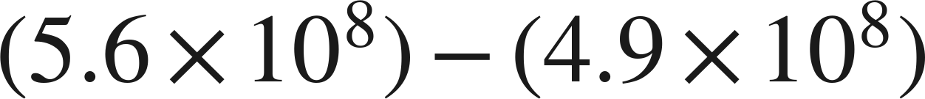
Whiteboards · Question 4 of 9
Boards up on three.
Answer it.
Finish the answer.
Grade 7 Accelerated · Unit 4 · Lesson 1 — Adding and Subtracting in Scientific Notation
21

Slide 24
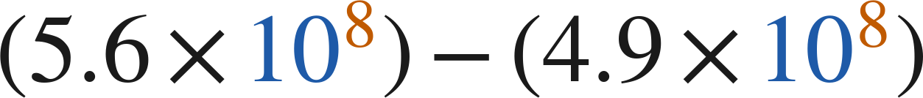
Whiteboards · Question 4 of 9
Answer.
0.7 × 10⁸ is not finished either
Answer: 7 × 10⁷
Grade 7 Accelerated · Unit 4 · Lesson 1 — Adding and Subtracting in Scientific Notation
22

Slide 25
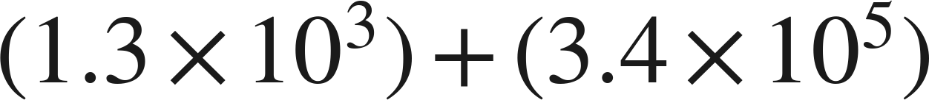
Whiteboards · Question 5 of 9
Boards up on three.
Which is the sum?
A. 4.7 × 10⁵
B. 4.7 × 10⁸
C. 3.413 × 10⁵
D. 3.53 × 10⁵
Answer it.
Grade 7 Accelerated · Unit 4 · Lesson 1 — Adding and Subtracting in Scientific Notation
23

Slide 26
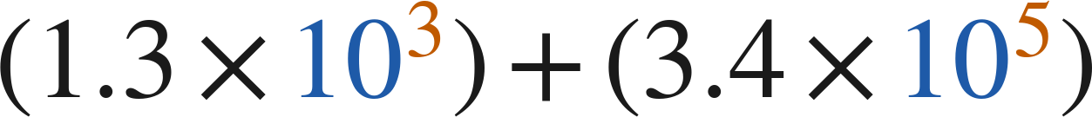
Whiteboards · Question 5 of 9
Answer.
Which is the sum?
A. 4.7 × 10⁵
B. 4.7 × 10⁸
C. 3.413 × 10⁵
D. 3.53 × 10⁵
Answer: C — 3.413 × 10⁵
Grade 7 Accelerated · Unit 4 · Lesson 1 — Adding and Subtracting in Scientific Notation
24

Slide 27
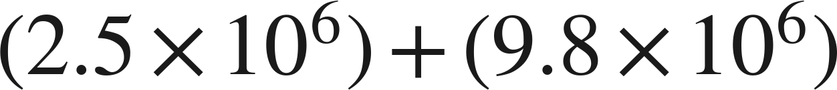
Whiteboards · Question 6 of 9
Boards up on three.
Which is the sum, written in scientific notation?
A. 12.3 × 10⁶
B. 12.3 × 10¹²
C. 1.23 × 10⁶
D. 1.23 × 10⁷
Answer it.
Grade 7 Accelerated · Unit 4 · Lesson 1 — Adding and Subtracting in Scientific Notation
25

Slide 28
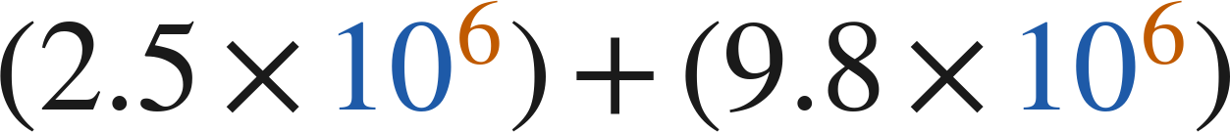
Whiteboards · Question 6 of 9
Answer.
Which is the sum, written in scientific notation?
A. 12.3 × 10⁶
B. 12.3 × 10¹²
C. 1.23 × 10⁶
D. 1.23 × 10⁷
Answer: D — 1.23 × 10⁷
Grade 7 Accelerated · Unit 4 · Lesson 1 — Adding and Subtracting in Scientific Notation
26

Slide 29
Whiteboards · Question 7 of 9
Boards up on three.
Answer it.
Rewrite one of them first.
Grade 7 Accelerated · Unit 4 · Lesson 1 — Adding and Subtracting in Scientific Notation
27

Slide 30
Whiteboards · Question 7 of 9
Answer.
6.4 × 10⁻³ = 0.64 × 10⁻²
Answer: 7.16 × 10⁻²
Grade 7 Accelerated · Unit 4 · Lesson 1 — Adding and Subtracting in Scientific Notation
28

Slide 31

Whiteboards · Question 8 of 9
Boards up on three.
What is the value of
?
Answer it.
Rewrite the answer over 10⁶ first.
Grade 7 Accelerated · Unit 4 · Lesson 1 — Adding and Subtracting in Scientific Notation
29

Slide 32
Whiteboards · Question 8 of 9
Answer.
What is the value of
?
1.02 × 10⁷ = 10.2 × 10⁶
Answer: n = 5.7
Grade 7 Accelerated · Unit 4 · Lesson 1 — Adding and Subtracting in Scientific Notation
30

Slide 33
Whiteboards · Question 9 of 9
Take your time. Boards up when you have written it.
Devon writes
.
Name the two mistakes he made, and give the correct sum.
Write your answer in sentences.
Two mistakes, then the sum.
Grade 7 Accelerated · Unit 4 · Lesson 1 — Adding and Subtracting in Scientific Notation
31

Slide 34
Whiteboards · Question 9 of 9
Answer.
Devon writes
.
Name the two mistakes he made, and give the correct sum.
one mistake in the coefficients, one in the exponents
Answer: 3.413 × 10⁵
Grade 7 Accelerated · Unit 4 · Lesson 1 — Adding and Subtracting in Scientific Notation
32

Slide 35
Independent Set
Six questions. On your own, in silence.
1.
Six questions. Work down the page.
2.
Show the step that does the work, not just the answer.
3.
Silence until the six minutes are up.
Grade 7 Accelerated · Unit 4 · Lesson 1 — Adding and Subtracting in Scientific Notation
33

Slide 36
IXL
Last five minutes.
1.
Open IXL and start today's skills.
2.
Work on paper where the question needs work. The answer box does not show it.
3.
Every skill listed is required, to a SmartScore of 67. Due at the start of the next class.
Today's skills — all required
Add and subtract numbers written in scientific notation — HUR
Grade 7 Accelerated · Unit 4 · Lesson 1 — Adding and Subtracting in Scientific Notation
34

Slide 37
GRADE 7 ACCELERATED · UNIT 4 · LESSONS 2–3
Multiplying and Dividing in Scientific Notation
MA.8.NSO.1.5
I can multiply and divide two numbers written in scientific notation, and write the answer in scientific notation.
Yesterday the powers of ten had to match before you could add.
Today they do not have to match at all — and they can be as far apart as they like.
Grade 7 Accelerated · Unit 4 · Lessons 2–3 — Multiplying and Dividing in Scientific Notation
1

Slide 38
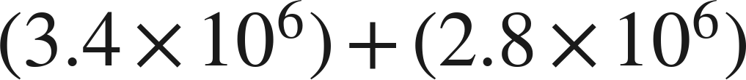
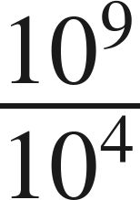
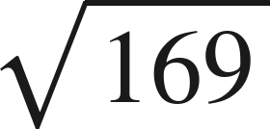
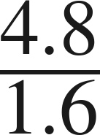
Warm-Up
On your own. Four minutes. No notes.
1.
2. Write as one power:
3. Find the value:
4. Find the quotient:
Grade 7 Accelerated · Unit 4 · Lessons 2–3 — Multiplying and Dividing in Scientific Notation
2

Slide 39
Warm-Up
Answers.
1.
6.2 × 10⁶
2. Write as one power:
10⁵
3. Find the value:
13
4. Find the quotient:
3
Grade 7 Accelerated · Unit 4 · Lessons 2–3 — Multiplying and Dividing in Scientific Notation
3

Slide 40

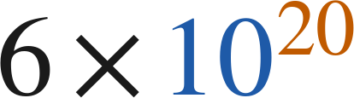
Notes
Copy both lines.
I. Multiplying: regroup, then use the laws
, never
Multiply the coefficients. Add the exponents — that is the product of powers law, not a new rule.
Grade 7 Accelerated · Unit 4 · Lessons 2–3 — Multiplying and Dividing in Scientific Notation
4

Slide 41
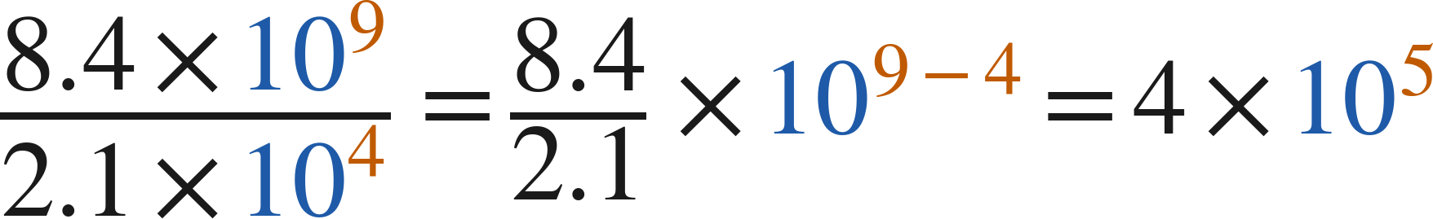
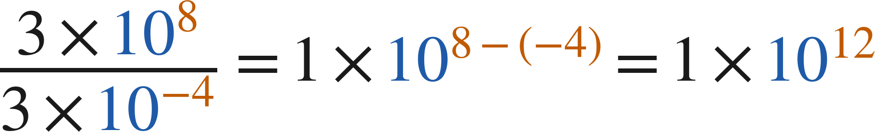
Notes
II. Dividing: the same move with the quotient law
Divide the coefficients. Subtract the exponents, top minus bottom.
Grade 7 Accelerated · Unit 4 · Lessons 2–3 — Multiplying and Dividing in Scientific Notation
5

Slide 42
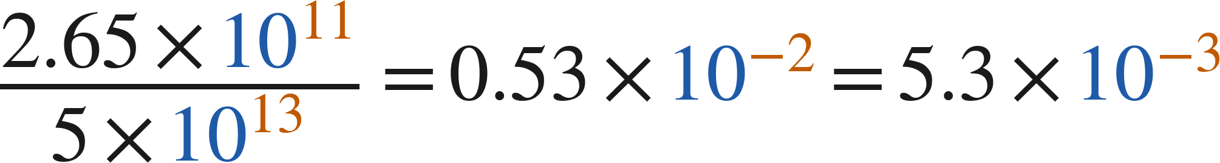
Notes
III. Finish the answer — both directions
Every answer ends with a coefficient at least 1 and less than 10.
Grade 7 Accelerated · Unit 4 · Lessons 2–3 — Multiplying and Dividing in Scientific Notation
6

Slide 43
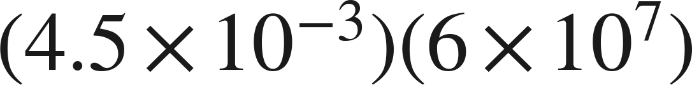
Example 1
Multiplying, and the answer needs finishing.
Multiply. Write the answer in scientific notation.
Grade 7 Accelerated · Unit 4 · Lessons 2–3 — Multiplying and Dividing in Scientific Notation
7

Slide 44
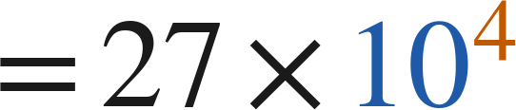

Example 1
Worked.
regroup
multiply the coefficients, add the exponents
27 is not less than 10: point one place left, exponent up one
Answer: 2.7 × 10⁵
Grade 7 Accelerated · Unit 4 · Lessons 2–3 — Multiplying and Dividing in Scientific Notation
8

Slide 45
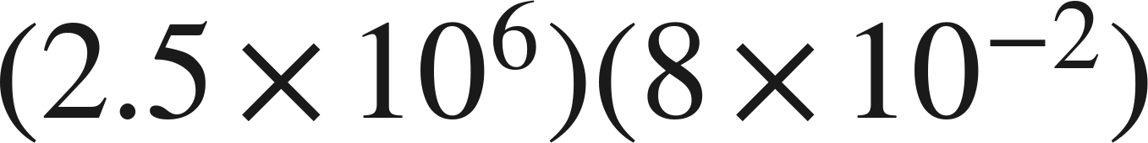
Your Turn
Same steps, your numbers. Boards up when done.
Grade 7 Accelerated · Unit 4 · Lessons 2–3 — Multiplying and Dividing in Scientific Notation
9

Slide 46
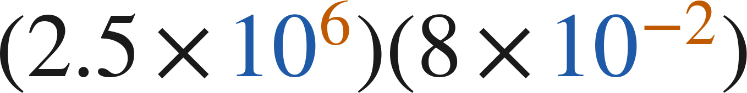
Your Turn
Answer.
20 × 10⁴, then repair
Answer: 2 × 10⁵
Grade 7 Accelerated · Unit 4 · Lessons 2–3 — Multiplying and Dividing in Scientific Notation
10

Slide 47
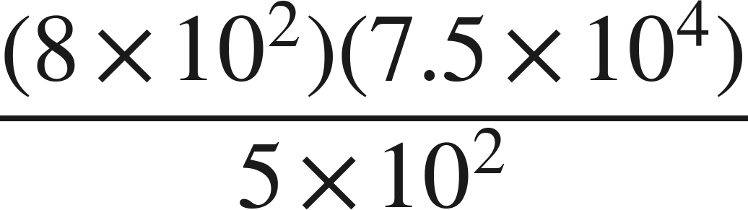
Example 2
Multiplication and division in one expression.
Evaluate. Write the answer in scientific notation.
Grade 7 Accelerated · Unit 4 · Lessons 2–3 — Multiplying and Dividing in Scientific Notation
11

Slide 48
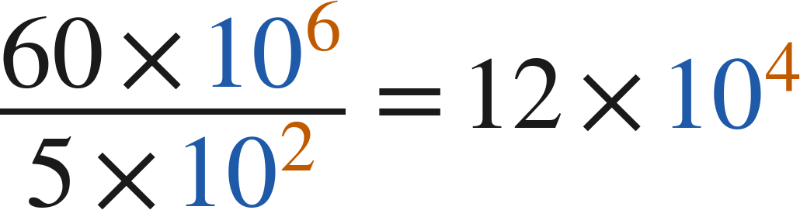

Example 2
Worked.
the top, regrouped
divide the coefficients, subtract the exponents
finish
Answer: 1.2 × 10⁵
Grade 7 Accelerated · Unit 4 · Lessons 2–3 — Multiplying and Dividing in Scientific Notation
12

Slide 49
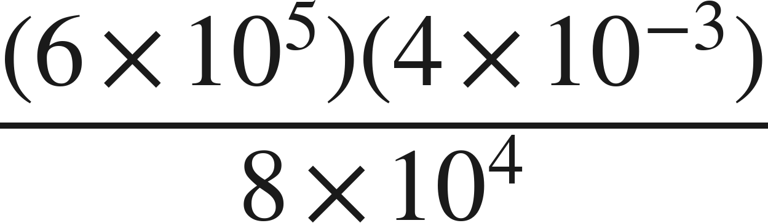
Your Turn
Same steps, your numbers. Boards up when done.
Grade 7 Accelerated · Unit 4 · Lessons 2–3 — Multiplying and Dividing in Scientific Notation
13

Slide 50
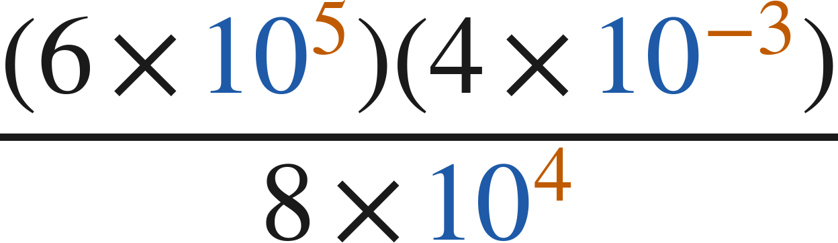
Your Turn
Answer.
24 × 10² over 8 × 10⁴
Answer: 3 × 10⁻²
Grade 7 Accelerated · Unit 4 · Lessons 2–3 — Multiplying and Dividing in Scientific Notation
14

Slide 51
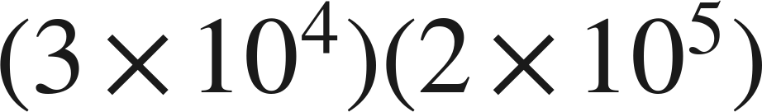
Whiteboards · Question 1 of 9
Boards up on three.
Answer it.
Multiply the fronts, add the backs.
Grade 7 Accelerated · Unit 4 · Lessons 2–3 — Multiplying and Dividing in Scientific Notation
15

Slide 52
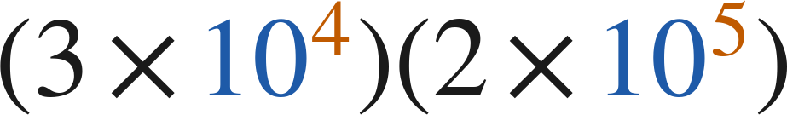
Whiteboards · Question 1 of 9
Answer.
3 · 2 and 10⁴ · 10⁵
Answer: 6 × 10⁹
Grade 7 Accelerated · Unit 4 · Lessons 2–3 — Multiplying and Dividing in Scientific Notation
16

Slide 53


Whiteboards · Question 2 of 9
Boards up on three.
A printer makes
copies per hour.
It runs for
hours. Paper costs 3 cents a sheet.
How many copies does it make?
Answer it.
Grade 7 Accelerated · Unit 4 · Lessons 2–3 — Multiplying and Dividing in Scientific Notation
17

Slide 54


Whiteboards · Question 2 of 9
Answer.
A printer makes
copies per hour.
It runs for
hours. Paper costs 3 cents a sheet.
How many copies does it make?
10 × 10⁵, then finish
Answer: 1 × 10⁶
Grade 7 Accelerated · Unit 4 · Lessons 2–3 — Multiplying and Dividing in Scientific Notation
18

Slide 55
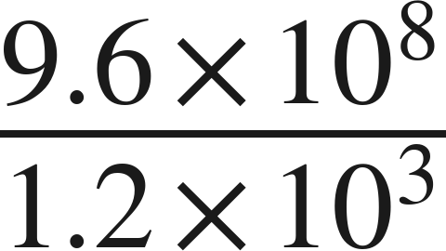
Whiteboards · Question 3 of 9
Boards up on three.
Answer it.
Top minus bottom.
Grade 7 Accelerated · Unit 4 · Lessons 2–3 — Multiplying and Dividing in Scientific Notation
19

Slide 56
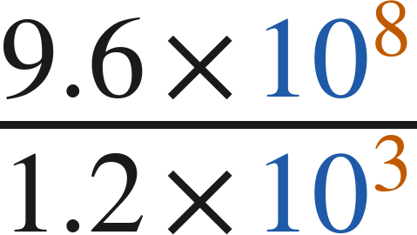
Whiteboards · Question 3 of 9
Answer.
9.6 ÷ 1.2 and 10⁸ ÷ 10³
Answer: 8 × 10⁵
Grade 7 Accelerated · Unit 4 · Lessons 2–3 — Multiplying and Dividing in Scientific Notation
20

Slide 57
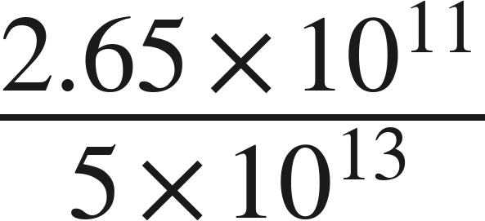
Whiteboards · Question 4 of 9
Boards up on three.
Answer it.
Finish the answer.
Grade 7 Accelerated · Unit 4 · Lessons 2–3 — Multiplying and Dividing in Scientific Notation
21

Slide 58
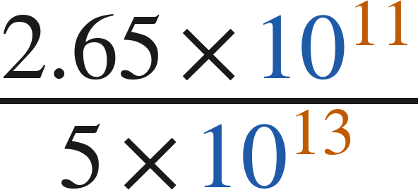
Whiteboards · Question 4 of 9
Answer.
0.53 × 10⁻² is not finished
Answer: 5.3 × 10⁻³
Grade 7 Accelerated · Unit 4 · Lessons 2–3 — Multiplying and Dividing in Scientific Notation
22

Slide 59
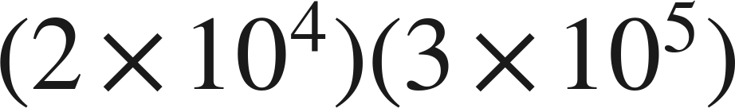
Whiteboards · Question 5 of 9
Boards up on three.
Which is the product?
A. 6 × 10⁻¹
B. 6 × 10²⁰
C. 6 × 10⁹
D. 5 × 10⁹
Answer it.
Grade 7 Accelerated · Unit 4 · Lessons 2–3 — Multiplying and Dividing in Scientific Notation
23

Slide 60
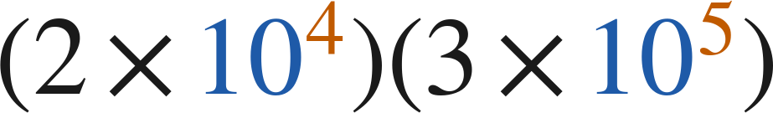
Whiteboards · Question 5 of 9
Answer.
Which is the product?
A. 6 × 10⁻¹
B. 6 × 10²⁰
C. 6 × 10⁹
D. 5 × 10⁹
Answer: C — 6 × 10⁹
Grade 7 Accelerated · Unit 4 · Lessons 2–3 — Multiplying and Dividing in Scientific Notation
24

Slide 61
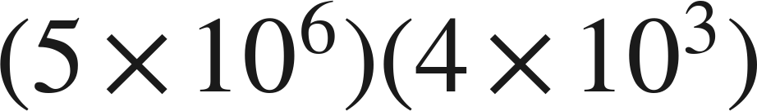
Whiteboards · Question 6 of 9
Boards up on three.
Which is the product, written in scientific notation?
A. 2 × 10⁹
B. 20 × 10⁹
C. 20 × 10¹⁸
D. 2 × 10¹⁰
Answer it.
Grade 7 Accelerated · Unit 4 · Lessons 2–3 — Multiplying and Dividing in Scientific Notation
25

Slide 62
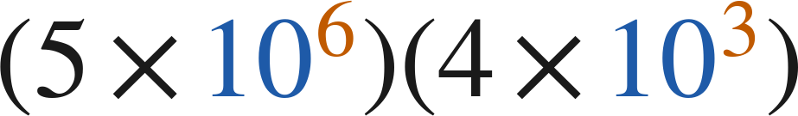
Whiteboards · Question 6 of 9
Answer.
Which is the product, written in scientific notation?
A. 2 × 10⁹
B. 20 × 10⁹
C. 20 × 10¹⁸
D. 2 × 10¹⁰
Answer: D — 2 × 10¹⁰
Grade 7 Accelerated · Unit 4 · Lessons 2–3 — Multiplying and Dividing in Scientific Notation
26

Slide 63
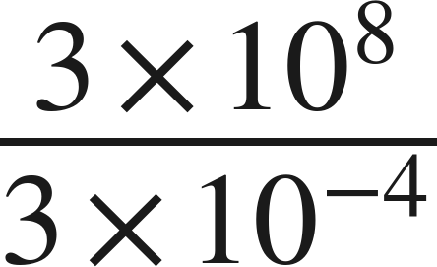
Whiteboards · Question 7 of 9
Boards up on three.
Answer it.
Top minus bottom, and the bottom is negative.
Grade 7 Accelerated · Unit 4 · Lessons 2–3 — Multiplying and Dividing in Scientific Notation
27

Slide 64
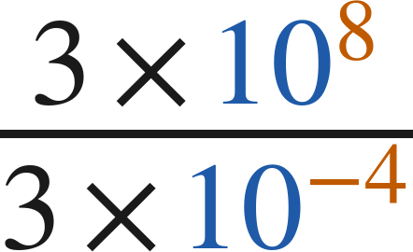
Whiteboards · Question 7 of 9
Answer.
8 − (−4) = 12
Answer: 1 × 10¹²
Grade 7 Accelerated · Unit 4 · Lessons 2–3 — Multiplying and Dividing in Scientific Notation
28

Slide 65
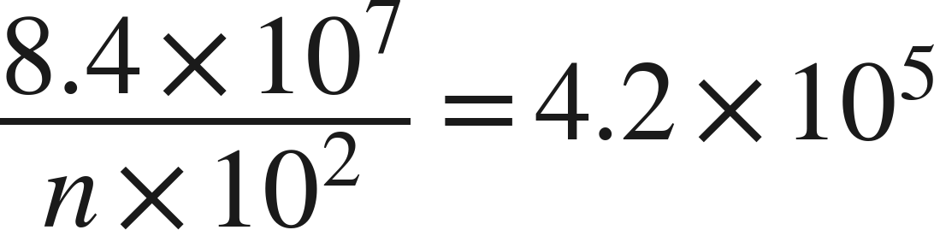
Whiteboards · Question 8 of 9
Boards up on three.
What is the value of
?
Answer it.
Look at the coefficients alone.
Grade 7 Accelerated · Unit 4 · Lessons 2–3 — Multiplying and Dividing in Scientific Notation
29

Slide 66
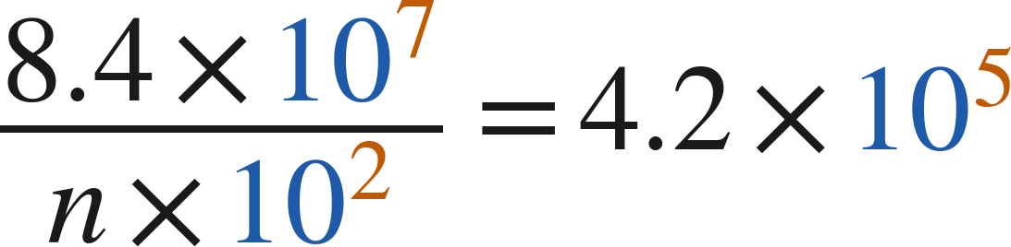
Whiteboards · Question 8 of 9
Answer.
What is the value of
?
8.4 ÷ n = 4.2
Answer: n = 2
Grade 7 Accelerated · Unit 4 · Lessons 2–3 — Multiplying and Dividing in Scientific Notation
30

Slide 67
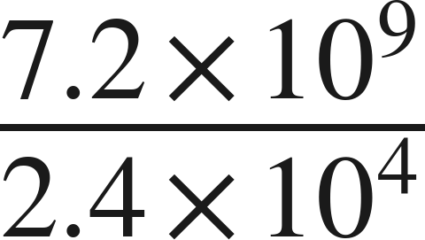
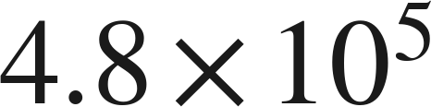
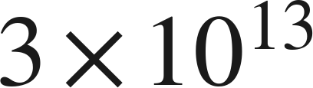
Whiteboards · Question 9 of 9
Take your time. Boards up when you have written it.
For
Marcus writes
and Sara writes
Name what each one did wrong, and give the correct quotient.
Write your answer in sentences.
Each one got exactly one half right.
Grade 7 Accelerated · Unit 4 · Lessons 2–3 — Multiplying and Dividing in Scientific Notation
31

Slide 68
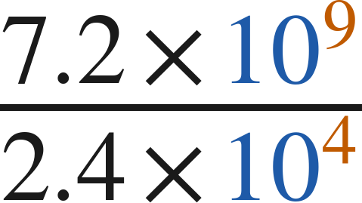
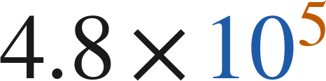

Whiteboards · Question 9 of 9
Answer.
For
Marcus writes
and Sara writes
Name what each one did wrong, and give the correct quotient.
one wrong in front, one wrong behind
Answer: 3 × 10⁵
Grade 7 Accelerated · Unit 4 · Lessons 2–3 — Multiplying and Dividing in Scientific Notation
32

Slide 69
Independent Set
Six questions. On your own, in silence.
1.
Six questions. Work down the page.
2.
Show the step that does the work, not just the answer.
3.
Silence until the six minutes are up.
Grade 7 Accelerated · Unit 4 · Lessons 2–3 — Multiplying and Dividing in Scientific Notation
33

Slide 70
IXL
Last five minutes.
1.
Open IXL and start today's skills.
2.
Work on paper where the question needs work. The answer box does not show it.
3.
Every skill listed is required, to a SmartScore of 67. Due at the start of the next class.
Today's skills — all required
Multiply numbers written in scientific notation — YZU
Divide numbers written in scientific notation — SGT
Grade 7 Accelerated · Unit 4 · Lessons 2–3 — Multiplying and Dividing in Scientific Notation
34

Slide 71
GRADE 7 ACCELERATED · UNIT 4 · LESSON 4
Real-World Problems and Significant Digits
MA.8.NSO.1.6
I can solve a real-world problem with numbers in scientific notation and report the answer with the right number of significant digits.
Yesterday you multiplied and divided in scientific notation.
Today the numbers are measurements — and a measurement only knows so much.
Grade 7 Accelerated · Unit 4 · Lesson 4 — Real-World Problems and Significant Digits
1

Slide 72


Warm-Up
On your own. Four minutes. No notes.
1.
2.
3. Write 0.00902 in scientific notation.
4. Round 4.738 to the nearest hundredth.
Grade 7 Accelerated · Unit 4 · Lesson 4 — Real-World Problems and Significant Digits
2

Slide 73
Warm-Up
Answers.
1.
1.2 × 10⁴
2.
5.89 × 10⁷
3. Write 0.00902 in scientific notation.
9.02 × 10⁻³
4. Round 4.738 to the nearest hundredth.
4.74
Grade 7 Accelerated · Unit 4 · Lesson 4 — Real-World Problems and Significant Digits
3

Slide 74
Notes
Copy the table.
I. Which digits are significant
Measurement | Digits | Why
4,207 | 4 | the middle zero counts
0.0058 | 2 | leading zeros never count
3.200 | 4 | trailing zeros count after a decimal point
52,000 | 2 | no decimal point, so they do not
Grade 7 Accelerated · Unit 4 · Lesson 4 — Real-World Problems and Significant Digits
4

Slide 75

Notes
II. Multiplying or dividing: count the digits
2 significant digits and 3, so the answer keeps 2:
Multiply or divide: the answer takes the smaller of the two significant-digit counts.
Grade 7 Accelerated · Unit 4 · Lesson 4 — Real-World Problems and Significant Digits
5

Slide 76


Notes
Copy all three lines.
III. Adding or subtracting: a different rule
1,234 stops at the ones place; 5.6 stops at the tenths
so the sum stops at the ones place:
Add or subtract: the answer stops at the leftmost of the two last-digit places.
Grade 7 Accelerated · Unit 4 · Lesson 4 — Real-World Problems and Significant Digits
6

Slide 77


Example 1
A product of two measurements.
A solar array measures
m by
m.
What is its area?
Give the answer to the correct number of significant digits.
Grade 7 Accelerated · Unit 4 · Lesson 4 — Real-World Problems and Significant Digits
7

Slide 78
Example 1
Worked.
multiply in full
the answer keeps 2
round once, at the end
Answer: 1.1 × 10⁴ square meters
Grade 7 Accelerated · Unit 4 · Lesson 4 — Real-World Problems and Significant Digits
8

Slide 79


Your Turn
Same steps, your numbers. Boards up when done.
A field measures
m by
m.
What is its area?
Grade 7 Accelerated · Unit 4 · Lesson 4 — Real-World Problems and Significant Digits
9

Slide 80


Your Turn
Answer.
A field measures
m by
m.
What is its area?
108,100, kept to two significant digits
Answer: 1.1 × 10⁵ square meters
Grade 7 Accelerated · Unit 4 · Lesson 4 — Real-World Problems and Significant Digits
10

Slide 81


Example 2
A difference of two measurements.
A container holds
cubic feet of liquid.
cubic feet evaporates.
How much is left? Give the answer with the correct precision.
Grade 7 Accelerated · Unit 4 · Lesson 4 — Real-World Problems and Significant Digits
11

Slide 82

Example 2
Worked.
subtract in full
the leftmost last-digit place
round there
Answer: 3.06 × 10⁻³ cubic feet
Grade 7 Accelerated · Unit 4 · Lesson 4 — Real-World Problems and Significant Digits
12

Slide 83


Your Turn
Same steps, your numbers. Boards up when done.
A road is
m long.
A section
m long is repaved.
How much of the road is not repaved?
Grade 7 Accelerated · Unit 4 · Lesson 4 — Real-World Problems and Significant Digits
13

Slide 84


Your Turn
Answer.
A road is
m long.
A section
m long is repaved.
How much of the road is not repaved?
3,576, stopped at the tens place
Answer: 3.58 × 10³ m
Grade 7 Accelerated · Unit 4 · Lesson 4 — Real-World Problems and Significant Digits
14

Slide 85
Whiteboards · Question 1 of 9
Boards up on three.
How many significant digits are in 0.00470 ?
Answer it.
Leading zeros, then trailing zeros.
Grade 7 Accelerated · Unit 4 · Lesson 4 — Real-World Problems and Significant Digits
15

Slide 86
Whiteboards · Question 1 of 9
Answer.
How many significant digits are in 0.00470 ?
4, 7 and the last 0
Answer: 3
Grade 7 Accelerated · Unit 4 · Lesson 4 — Real-World Problems and Significant Digits
16

Slide 87


Whiteboards · Question 2 of 9
Boards up on three.
A pond's surface measures
m by
m.
The pond is 3 meters deep.
Find the surface area. Round to the correct number of significant digits.
Answer it.
Grade 7 Accelerated · Unit 4 · Lesson 4 — Real-World Problems and Significant Digits
17

Slide 88


Whiteboards · Question 2 of 9
Answer.
A pond's surface measures
m by
m.
The pond is 3 meters deep.
Find the surface area. Round to the correct number of significant digits.
11,900, kept to two digits
Answer: 1.2 × 10⁴ square meters
Grade 7 Accelerated · Unit 4 · Lesson 4 — Real-World Problems and Significant Digits
18

Slide 89

Whiteboards · Question 3 of 9
Boards up on three.
Two measurements are multiplied. One has 3 significant digits
and the other has 5. The exact product is
.
How should the answer be written?
Answer it.
Which count wins?
Grade 7 Accelerated · Unit 4 · Lesson 4 — Real-World Problems and Significant Digits
19

Slide 90

Whiteboards · Question 3 of 9
Answer.
Two measurements are multiplied. One has 3 significant digits
and the other has 5. The exact product is
.
How should the answer be written?
the smaller count
Answer: 7.41 × 10⁵
Grade 7 Accelerated · Unit 4 · Lesson 4 — Real-World Problems and Significant Digits
20

Slide 91

Whiteboards · Question 4 of 9
Boards up on three.
meters, both measured.
Write the sum with the correct precision.
Answer it.
Where does each one's last digit sit?
Grade 7 Accelerated · Unit 4 · Lesson 4 — Real-World Problems and Significant Digits
21

Slide 92

Whiteboards · Question 4 of 9
Answer.
meters, both measured.
Write the sum with the correct precision.
2,500 stops at the hundreds
Answer: 3.0 × 10³ m
Grade 7 Accelerated · Unit 4 · Lesson 4 — Real-World Problems and Significant Digits
22

Slide 93
Whiteboards · Question 5 of 9
Boards up on three.
How many significant digits are in 0.03080 ?
A. 4
B. 2
C. 5
D. 3
Answer it.
Grade 7 Accelerated · Unit 4 · Lesson 4 — Real-World Problems and Significant Digits
23

Slide 94
Whiteboards · Question 5 of 9
Answer.
How many significant digits are in 0.03080 ?
A. 4
B. 2
C. 5
D. 3
Answer: A — 4
Grade 7 Accelerated · Unit 4 · Lesson 4 — Real-World Problems and Significant Digits
24

Slide 95


Whiteboards · Question 6 of 9
Boards up on three.
A rectangle measures
cm by
cm.
Which is the area, to the correct significant digits?
A. 26.1 × 10⁴ cm²
B. 2.6 × 10⁵ cm²
C. 2.6 × 10⁴ cm²
D. 2.61 × 10⁵ cm²
Answer it.
Grade 7 Accelerated · Unit 4 · Lesson 4 — Real-World Problems and Significant Digits
25

Slide 96


Whiteboards · Question 6 of 9
Answer.
A rectangle measures
cm by
cm.
Which is the area, to the correct significant digits?
A. 26.1 × 10⁴ cm²
B. 2.6 × 10⁵ cm²
C. 2.6 × 10⁴ cm²
D. 2.61 × 10⁵ cm²
Answer: B — 2.6 × 10⁵ cm²
Grade 7 Accelerated · Unit 4 · Lesson 4 — Real-World Problems and Significant Digits
26

Slide 97

Whiteboards · Question 7 of 9
Boards up on three.
A car travels
km in 3.0 hours.
What is its average speed, to the right number of significant digits?
Answer it.
Count both measurements.
Grade 7 Accelerated · Unit 4 · Lesson 4 — Real-World Problems and Significant Digits
27

Slide 98

Whiteboards · Question 7 of 9
Answer.
A car travels
km in 3.0 hours.
What is its average speed, to the right number of significant digits?
140 exactly, kept to two digits
Answer: 1.4 × 10² km/h
Grade 7 Accelerated · Unit 4 · Lesson 4 — Real-World Problems and Significant Digits
28

Slide 99


Whiteboards · Question 8 of 9
Boards up on three.
A measured length times a measured width gives an area
of
m². The length measured
m.
What did the width measure, to two significant digits?
Answer it.
Divide, then count.
Grade 7 Accelerated · Unit 4 · Lesson 4 — Real-World Problems and Significant Digits
29

Slide 100


Whiteboards · Question 8 of 9
Answer.
A measured length times a measured width gives an area
of
m². The length measured
m.
What did the width measure, to two significant digits?
3,600 ÷ 90
Answer: 4.0 × 10¹ m
Grade 7 Accelerated · Unit 4 · Lesson 4 — Real-World Problems and Significant Digits
30

Slide 101


Whiteboards · Question 9 of 9
Take your time. Boards up when you have written it.
Ellis says: 1,234 has 4 significant digits and 5.6 has 2,
so the sum
must be written with 2:
.
Explain why he is wrong, and give the correct sum.
Write your answer in sentences.
Which rule is for which operation?
Grade 7 Accelerated · Unit 4 · Lesson 4 — Real-World Problems and Significant Digits
31

Slide 102


Whiteboards · Question 9 of 9
Answer.
Ellis says: 1,234 has 4 significant digits and 5.6 has 2,
so the sum
must be written with 2:
.
Explain why he is wrong, and give the correct sum.
products count digits; sums count places
Answer: 1,240 = 1.240 × 10³
Grade 7 Accelerated · Unit 4 · Lesson 4 — Real-World Problems and Significant Digits
32

Slide 103
Independent Set
Six questions. On your own, in silence.
1.
Six questions. Work down the page.
2.
Show the step that does the work, not just the answer.
3.
Silence until the six minutes are up.
Grade 7 Accelerated · Unit 4 · Lesson 4 — Real-World Problems and Significant Digits
33

Slide 104
IXL
Last five minutes.
1.
Open IXL and start today's skills.
2.
Work on paper where the question needs work. The answer box does not show it.
3.
Every skill listed is required, to a SmartScore of 67. Due at the start of the next class.
Today's skills — all required
Add, subtract, multiply, and divide numbers written in scientific notation: word problems — D5S
Grade 7 Accelerated · Unit 4 · Lesson 4 — Real-World Problems and Significant Digits
34

Slide 105
GRADE 7 ACCELERATED · UNIT 4 · LESSON 5
Evaluating Expressions with Radicals
MA.8.NSO.1.7
I can evaluate an expression that contains square roots, cube roots and integer exponents.
Yesterday every number was a measurement.
Today the radical sign comes back — and its bar is a grouping symbol.
Grade 7 Accelerated · Unit 4 · Lesson 5 — Evaluating Expressions with Radicals
1

Slide 106



Warm-Up
On your own. Four minutes. No notes.
1. How many significant digits are in 0.0250 ?
2.
3. Find the value:
4. Evaluate:
Grade 7 Accelerated · Unit 4 · Lesson 5 — Evaluating Expressions with Radicals
2

Slide 107
Warm-Up
Answers.
1. How many significant digits are in 0.0250 ?
3
2.
6 × 10⁻³
3. Find the value:
14
4. Evaluate:
8
Grade 7 Accelerated · Unit 4 · Lesson 5 — Evaluating Expressions with Radicals
3

Slide 108



Notes
Copy all three lines.
I. The radical bar is a grouping symbol
, never
Everything under the bar is evaluated before the root is taken.
Grade 7 Accelerated · Unit 4 · Lesson 5 — Evaluating Expressions with Radicals
4

Slide 109





Notes
II. Square roots and cube roots are not the same shape
An odd root keeps the sign of its radicand. A square root sign never gives a negative value.
Grade 7 Accelerated · Unit 4 · Lesson 5 — Evaluating Expressions with Radicals
5

Slide 110



Notes
III. Radicals alongside exponents
Finish each piece — the radical, the power — and only then put them together.
Grade 7 Accelerated · Unit 4 · Lesson 5 — Evaluating Expressions with Radicals
6

Slide 111

Example 1
A power and a radical in one expression.
Evaluate.
Grade 7 Accelerated · Unit 4 · Lesson 5 — Evaluating Expressions with Radicals
7

Slide 112


Example 1
Worked.
square the whole base, sign included
finish under the bar, then take the root
combine
Answer: 17/4
Grade 7 Accelerated · Unit 4 · Lesson 5 — Evaluating Expressions with Radicals
8

Slide 113

Your Turn
Same steps, your numbers. Boards up when done.
Grade 7 Accelerated · Unit 4 · Lesson 5 — Evaluating Expressions with Radicals
9

Slide 114

Your Turn
Answer.
1/9 minus 2
Answer: −17/9
Grade 7 Accelerated · Unit 4 · Lesson 5 — Evaluating Expressions with Radicals
10

Slide 115

Example 2
A radical inside a product.
Evaluate.
Grade 7 Accelerated · Unit 4 · Lesson 5 — Evaluating Expressions with Radicals
11

Slide 116



Example 2
Worked.
the two innermost pieces
the root, then the product
subtract last
Answer: 0.2
Grade 7 Accelerated · Unit 4 · Lesson 5 — Evaluating Expressions with Radicals
12

Slide 117

Your Turn
Same steps, your numbers. Boards up when done.
Grade 7 Accelerated · Unit 4 · Lesson 5 — Evaluating Expressions with Radicals
13

Slide 118

Your Turn
Answer.
−2 plus 10
Answer: 8
Grade 7 Accelerated · Unit 4 · Lesson 5 — Evaluating Expressions with Radicals
14

Slide 119

Whiteboards · Question 1 of 9
Boards up on three.
Answer it.
What times itself?
Grade 7 Accelerated · Unit 4 · Lesson 5 — Evaluating Expressions with Radicals
15

Slide 120

Whiteboards · Question 1 of 9
Answer.
11 · 11
Answer: 11
Grade 7 Accelerated · Unit 4 · Lesson 5 — Evaluating Expressions with Radicals
16

Slide 121
Whiteboards · Question 2 of 9
Boards up on three.
A square patio has an area of 169 square feet.
Fencing for it costs 12 dollars a foot.
How long is one side of the patio?
Answer it.
Grade 7 Accelerated · Unit 4 · Lesson 5 — Evaluating Expressions with Radicals
17

Slide 122
Whiteboards · Question 2 of 9
Answer.
A square patio has an area of 169 square feet.
Fencing for it costs 12 dollars a foot.
How long is one side of the patio?
√169
Answer: 13 feet
Grade 7 Accelerated · Unit 4 · Lesson 5 — Evaluating Expressions with Radicals
18

Slide 123

Whiteboards · Question 3 of 9
Boards up on three.
Answer it.
What number, three times?
Grade 7 Accelerated · Unit 4 · Lesson 5 — Evaluating Expressions with Radicals
19

Slide 124

Whiteboards · Question 3 of 9
Answer.
(−5)(−5)(−5)
Answer: −5
Grade 7 Accelerated · Unit 4 · Lesson 5 — Evaluating Expressions with Radicals
20

Slide 125

Whiteboards · Question 4 of 9
Boards up on three.
Answer it.
Finish under the bar first.
Grade 7 Accelerated · Unit 4 · Lesson 5 — Evaluating Expressions with Radicals
21

Slide 126

Whiteboards · Question 4 of 9
Answer.
8 + 17 = 25
Answer: 5
Grade 7 Accelerated · Unit 4 · Lesson 5 — Evaluating Expressions with Radicals
22

Slide 127

Whiteboards · Question 5 of 9
Boards up on three.
Which is the value?
A. 7
B. 25
C. 12.5
D. 5
Answer it.
Grade 7 Accelerated · Unit 4 · Lesson 5 — Evaluating Expressions with Radicals
23

Slide 128

Whiteboards · Question 5 of 9
Answer.
Which is the value?
A. 7
B. 25
C. 12.5
D. 5
Answer: D — 5
Grade 7 Accelerated · Unit 4 · Lesson 5 — Evaluating Expressions with Radicals
24

Slide 129

Whiteboards · Question 6 of 9
Boards up on three.
Which is the value?
A. −4
B. not a real number
C. −8
D. 4
Answer it.
Grade 7 Accelerated · Unit 4 · Lesson 5 — Evaluating Expressions with Radicals
25

Slide 130

Whiteboards · Question 6 of 9
Answer.
Which is the value?
A. −4
B. not a real number
C. −8
D. 4
Answer: A — −4
Grade 7 Accelerated · Unit 4 · Lesson 5 — Evaluating Expressions with Radicals
26

Slide 131

Whiteboards · Question 7 of 9
Boards up on three.
Answer it.
Top and bottom each get the root.
Grade 7 Accelerated · Unit 4 · Lesson 5 — Evaluating Expressions with Radicals
27

Slide 132

Whiteboards · Question 7 of 9
Answer.
1/3 and 1/3
Answer: 2/3
Grade 7 Accelerated · Unit 4 · Lesson 5 — Evaluating Expressions with Radicals
28

Slide 133

Whiteboards · Question 8 of 9
Boards up on three.
Answer it.
Finish each piece, then multiply.
Grade 7 Accelerated · Unit 4 · Lesson 5 — Evaluating Expressions with Radicals
29

Slide 134

Whiteboards · Question 8 of 9
Answer.
5 times one hundred twenty-fifth
Answer: 1/25
Grade 7 Accelerated · Unit 4 · Lesson 5 — Evaluating Expressions with Radicals
30

Slide 135

Whiteboards · Question 9 of 9
Take your time. Boards up when you have written it.
Simon says that
is not a real number,
because you cannot take the root of a negative.
Explain why he is wrong, and give the value.
Write your answer in sentences.
Which root is he thinking of?
Grade 7 Accelerated · Unit 4 · Lesson 5 — Evaluating Expressions with Radicals
31

Slide 136

Whiteboards · Question 9 of 9
Answer.
Simon says that
is not a real number,
because you cannot take the root of a negative.
Explain why he is wrong, and give the value.
a cube root is not a square root
Answer: −3
Grade 7 Accelerated · Unit 4 · Lesson 5 — Evaluating Expressions with Radicals
32

Slide 137
Independent Set
Six questions. On your own, in silence.
1.
Six questions. Work down the page.
2.
Show the step that does the work, not just the answer.
3.
Silence until the six minutes are up.
Grade 7 Accelerated · Unit 4 · Lesson 5 — Evaluating Expressions with Radicals
33

Slide 138
IXL
Last five minutes.
1.
Open IXL and start today's skills.
2.
Work on paper where the question needs work. The answer box does not show it.
3.
Every skill listed is required, to a SmartScore of 67. This skill continues tomorrow: one assignment, due at the start of the class after 4.06.
Today's skills — all required
Evaluate radical expressions — D8J
Grade 7 Accelerated · Unit 4 · Lesson 5 — Evaluating Expressions with Radicals
34

Slide 139
GRADE 7 ACCELERATED · UNIT 4 · LESSON 6
Order of Operations with Radicals
MA.8.NSO.1.7
I can evaluate a multi-step expression with rational numbers, exponents and radicals by reading its structure.
Yesterday the radical bar grouped whatever sat under it.
Today every grouping symbol at once — and the order comes from the structure, not from a mnemonic.
Grade 7 Accelerated · Unit 4 · Lesson 6 — Order of Operations with Radicals
1

Slide 140



Warm-Up
On your own. Four minutes. No notes.
1.
2. How many significant digits are in 1.020 ?
3. Find the value:
4. Evaluate:
Grade 7 Accelerated · Unit 4 · Lesson 6 — Order of Operations with Radicals
2

Slide 141
Warm-Up
Answers.
1.
4
2. How many significant digits are in 1.020 ?
4
3. Find the value:
9/4
4. Evaluate:
8
Grade 7 Accelerated · Unit 4 · Lesson 6 — Order of Operations with Radicals
3

Slide 142
Notes
Copy the table.
I. The structure, not a mnemonic
 | Level | What it means
1 | Grouping symbols | ( ), [ ], the radical bar, the fraction bar
2 | Powers and roots | the same level as each other
3 | Multiply and divide | left to right
4 | Add and subtract | left to right
Innermost grouping symbol first, then out.
Grade 7 Accelerated · Unit 4 · Lesson 6 — Order of Operations with Radicals
4

Slide 143


Notes
II. Left to right means left to right
, never
, never
Multiplication and division are one level. Addition and subtraction are one level. Left to right, both times.
Grade 7 Accelerated · Unit 4 · Lesson 6 — Order of Operations with Radicals
5

Slide 144


Notes
III. The fraction bar groups, top and bottom
Finish the numerator and finish the denominator before you divide.
Grade 7 Accelerated · Unit 4 · Lesson 6 — Order of Operations with Radicals
6

Slide 145

Example 1
A grouping symbol inside a grouping symbol.
Evaluate.
Grade 7 Accelerated · Unit 4 · Lesson 6 — Order of Operations with Radicals
7

Slide 146


Example 1
Worked.
innermost: the power inside the parentheses
finish the parentheses, then multiply
the cube root is 5; add last
Answer: −1.44
Grade 7 Accelerated · Unit 4 · Lesson 6 — Order of Operations with Radicals
8

Slide 147

Your Turn
Same steps, your numbers. Boards up when done.
Grade 7 Accelerated · Unit 4 · Lesson 6 — Order of Operations with Radicals
9

Slide 148

Your Turn
Answer.
3(0.99) + 7
Answer: 9.97
Grade 7 Accelerated · Unit 4 · Lesson 6 — Order of Operations with Radicals
10

Slide 149

Example 2
A fraction bar and a radical in one expression.
Evaluate.
Grade 7 Accelerated · Unit 4 · Lesson 6 — Order of Operations with Radicals
11

Slide 150



Example 2
Worked.
numerator and denominator, each finished
under the bar, then the root
subtract last
Answer: −1/4
Grade 7 Accelerated · Unit 4 · Lesson 6 — Order of Operations with Radicals
12

Slide 151

Your Turn
Same steps, your numbers. Boards up when done.
Grade 7 Accelerated · Unit 4 · Lesson 6 — Order of Operations with Radicals
13

Slide 152

Your Turn
Answer.
a half plus a half
Answer: 1
Grade 7 Accelerated · Unit 4 · Lesson 6 — Order of Operations with Radicals
14

Slide 153

Whiteboards · Question 1 of 9
Boards up on three.
Answer it.
Left to right.
Grade 7 Accelerated · Unit 4 · Lesson 6 — Order of Operations with Radicals
15

Slide 154

Whiteboards · Question 1 of 9
Answer.
12 ÷ 3 first
Answer: 8
Grade 7 Accelerated · Unit 4 · Lesson 6 — Order of Operations with Radicals
16

Slide 155
Whiteboards · Question 2 of 9
Boards up on three.
A square tile has side
centimeters.
Its diagonal is about 19.8 centimeters.
What is the perimeter of the tile?
Answer it.
Grade 7 Accelerated · Unit 4 · Lesson 6 — Order of Operations with Radicals
17

Slide 156

Whiteboards · Question 2 of 9
Answer.
A square tile has side
centimeters.
Its diagonal is about 19.8 centimeters.
What is the perimeter of the tile?
4 sides of 14
Answer: 56 centimeters
Grade 7 Accelerated · Unit 4 · Lesson 6 — Order of Operations with Radicals
18

Slide 157

Whiteboards · Question 3 of 9
Boards up on three.
Answer it.
Left to right.
Grade 7 Accelerated · Unit 4 · Lesson 6 — Order of Operations with Radicals
19

Slide 158

Whiteboards · Question 3 of 9
Answer.
10 − 4 first
Answer: 9
Grade 7 Accelerated · Unit 4 · Lesson 6 — Order of Operations with Radicals
20

Slide 159

Whiteboards · Question 4 of 9
Boards up on three.
Answer it.
Finish the top and the bottom.
Grade 7 Accelerated · Unit 4 · Lesson 6 — Order of Operations with Radicals
21

Slide 160

Whiteboards · Question 4 of 9
Answer.
3 over 9
Answer: 1/3
Grade 7 Accelerated · Unit 4 · Lesson 6 — Order of Operations with Radicals
22

Slide 161

Whiteboards · Question 5 of 9
Boards up on three.
Which is the value?
A. 146
B. 50
C. 26
D. 80
Answer it.
Grade 7 Accelerated · Unit 4 · Lesson 6 — Order of Operations with Radicals
23

Slide 162

Whiteboards · Question 5 of 9
Answer.
Which is the value?
A. 146
B. 50
C. 26
D. 80
Answer: B — 50
Grade 7 Accelerated · Unit 4 · Lesson 6 — Order of Operations with Radicals
24

Slide 163

Whiteboards · Question 6 of 9
Boards up on three.
Which is the value?
A. 4
B. 35.5
C. 0.5
D. 256
Answer it.
Grade 7 Accelerated · Unit 4 · Lesson 6 — Order of Operations with Radicals
25

Slide 164

Whiteboards · Question 6 of 9
Answer.
Which is the value?
A. 4
B. 35.5
C. 0.5
D. 256
Answer: A — 4
Grade 7 Accelerated · Unit 4 · Lesson 6 — Order of Operations with Radicals
26

Slide 165

Whiteboards · Question 7 of 9
Boards up on three.
Answer it.
What is each exponent attached to?
Grade 7 Accelerated · Unit 4 · Lesson 6 — Order of Operations with Radicals
27

Slide 166

Whiteboards · Question 7 of 9
Answer.
−4 and +4
Answer: 0
Grade 7 Accelerated · Unit 4 · Lesson 6 — Order of Operations with Radicals
28

Slide 167

Whiteboards · Question 8 of 9
Boards up on three.
Answer it.
Inside first.
Grade 7 Accelerated · Unit 4 · Lesson 6 — Order of Operations with Radicals
29

Slide 168

Whiteboards · Question 8 of 9
Answer.
one eighth plus one ninth
Answer: 17/6
Grade 7 Accelerated · Unit 4 · Lesson 6 — Order of Operations with Radicals
30

Slide 169

Whiteboards · Question 9 of 9
Take your time. Boards up when you have written it.
Roscoe says that
is always positive,
because a square is always positive.
Is he right? Give a value of
that settles it.
Write your answer in sentences.
Try to make the inside zero.
Grade 7 Accelerated · Unit 4 · Lesson 6 — Order of Operations with Radicals
31

Slide 170

Whiteboards · Question 9 of 9
Answer.
Roscoe says that
is always positive,
because a square is always positive.
Is he right? Give a value of
that settles it.
never negative is not the same as always positive
Answer: No — at n = 121 the value is 0
Grade 7 Accelerated · Unit 4 · Lesson 6 — Order of Operations with Radicals
32

Slide 171
Independent Set
Six questions. On your own, in silence.
1.
Six questions. Work down the page.
2.
Show the step that does the work, not just the answer.
3.
Silence until the six minutes are up.
Grade 7 Accelerated · Unit 4 · Lesson 6 — Order of Operations with Radicals
33

Slide 172
IXL
Last five minutes.
1.
Open IXL and start today's skills.
2.
Work on paper where the question needs work. The answer box does not show it.
3.
Every skill listed is required, to a SmartScore of 67. Due at the start of the next class.
Today's skills — all required
Evaluate radical expressions — D8J
Grade 7 Accelerated · Unit 4 · Lesson 6 — Order of Operations with Radicals
34

Slide 173
GRADE 7 ACCELERATED · UNIT 4 · LESSONS 7–8
Real-World Order of Operations
MA.8.NSO.1.7
I can substitute values into a formula and evaluate it, reading what the situation does rather than hunting for key words.
Yesterday you read an expression's structure.
Today the expression arrives wrapped in a sentence — and the sentence is not a list of key words.
Grade 7 Accelerated · Unit 4 · Lessons 7–8 — Real-World Order of Operations
1

Slide 174





Warm-Up
On your own. Four minutes. No notes.
1.
2.
3. Find the value:
4. Evaluate
when
.
Grade 7 Accelerated · Unit 4 · Lessons 7–8 — Real-World Order of Operations
2

Slide 175
Warm-Up
Answers.
1.
0
2.
25/2
3. Find the value:
4/3
4. Evaluate
when
.
18
Grade 7 Accelerated · Unit 4 · Lessons 7–8 — Real-World Order of Operations
3

Slide 176







Notes
Copy both lines.
I. Substituting: the value goes in parentheses
with
and
:
joules
with
:
, never
Substitute in parentheses, then evaluate by the structure — powers before products.
Grade 7 Accelerated · Unit 4 · Lessons 7–8 — Real-World Order of Operations
4

Slide 177


Notes
Copy both problems.
II. Key words do not decide the operation
15 dollars plus 4 dollars for each of 6 gigabytes:
15 dollars for each of 4 lines, plus 6 dollars of tax:
The same words, the same numbers, different structures. Read the situation.
Grade 7 Accelerated · Unit 4 · Lessons 7–8 — Real-World Order of Operations
5

Slide 178


Notes
III. Round once, at the end — and say the unit
feet
rounding the side to 14 first:
feet
Carry the exact value, round once at the end, and write the unit.
Grade 7 Accelerated · Unit 4 · Lessons 7–8 — Real-World Order of Operations
6

Slide 179




Example 1
A formula with a power in it.
Kinetic energy is
,
for mass
in kilograms and speed
in meters per second.
Find
for a car of mass 1,200 kg travelling at 15 m/s.
Give the answer with its unit.
Grade 7 Accelerated · Unit 4 · Lessons 7–8 — Real-World Order of Operations
7

Slide 180


Example 1
Worked.
substitute, each value in parentheses
the power first — it belongs to the 15 alone
then the products
Answer: 135,000 joules
Grade 7 Accelerated · Unit 4 · Lessons 7–8 — Real-World Order of Operations
8

Slide 181



Your Turn
Same steps, your numbers. Boards up when done.
Find
for
kg and
m/s.
Grade 7 Accelerated · Unit 4 · Lessons 7–8 — Real-World Order of Operations
9

Slide 182



Your Turn
Answer.
Find
for
kg and
m/s.
425 times 144
Answer: 61,200 joules
Grade 7 Accelerated · Unit 4 · Lessons 7–8 — Real-World Order of Operations
10

Slide 183
Example 2
A cost with a rate and a flat fee.
A square floor of side 9 feet is carpeted.
Carpet is 2.89 dollars a square foot and padding is 0.75 dollars a square foot.
Installation is a flat 95 dollars. Find the total cost.
Grade 7 Accelerated · Unit 4 · Lessons 7–8 — Real-World Order of Operations
11

Slide 184


Example 2
Worked.
area times the per-square-foot prices, then the flat fee
the area and the rate, each finished
multiply, then add
Answer: 389.84 dollars
Grade 7 Accelerated · Unit 4 · Lessons 7–8 — Real-World Order of Operations
12

Slide 185
Your Turn
Same steps, your numbers. Boards up when done.
A square bathroom floor of side 6 feet is tiled.
Tile is 4.25 dollars a square foot and grout is a flat 13.48 dollars.
Find the total cost.
Grade 7 Accelerated · Unit 4 · Lessons 7–8 — Real-World Order of Operations
13

Slide 186
Your Turn
Answer.
A square bathroom floor of side 6 feet is tiled.
Tile is 4.25 dollars a square foot and grout is a flat 13.48 dollars.
Find the total cost.
36(4.25) then add
Answer: 166.48 dollars
Grade 7 Accelerated · Unit 4 · Lessons 7–8 — Real-World Order of Operations
14

Slide 187


Whiteboards · Question 1 of 9
Boards up on three.
Evaluate
when
.
Answer it.
Substitute in parentheses.
Grade 7 Accelerated · Unit 4 · Lessons 7–8 — Real-World Order of Operations
15

Slide 188


Whiteboards · Question 1 of 9
Answer.
Evaluate
when
.
3(−2)²
Answer: 12
Grade 7 Accelerated · Unit 4 · Lessons 7–8 — Real-World Order of Operations
16

Slide 189



Whiteboards · Question 2 of 9
Boards up on three.
A cyclist has a mass of 70 kilograms and rides at 8 meters per second.
Her bicycle cost 480 dollars.
Kinetic energy is
, for a mass
and a speed
.
Find her kinetic energy.
Answer it.
Grade 7 Accelerated · Unit 4 · Lessons 7–8 — Real-World Order of Operations
17

Slide 190

Whiteboards · Question 2 of 9
Answer.
A cyclist has a mass of 70 kilograms and rides at 8 meters per second.
Her bicycle cost 480 dollars.
Kinetic energy is
, for a mass
and a speed
.
Find her kinetic energy.
35 times 64
Answer: 2,240 joules
Grade 7 Accelerated · Unit 4 · Lessons 7–8 — Real-World Order of Operations
18

Slide 191
Whiteboards · Question 3 of 9
Boards up on three.
A plan costs 15 dollars plus 4 dollars for each gigabyte.
Find the cost of 6 gigabytes.
Answer it.
What happens six times?
Grade 7 Accelerated · Unit 4 · Lessons 7–8 — Real-World Order of Operations
19

Slide 192
Whiteboards · Question 3 of 9
Answer.
A plan costs 15 dollars plus 4 dollars for each gigabyte.
Find the cost of 6 gigabytes.
15 + 4(6)
Answer: 39 dollars
Grade 7 Accelerated · Unit 4 · Lessons 7–8 — Real-World Order of Operations
20

Slide 193
Whiteboards · Question 4 of 9
Boards up on three.
A square floor of side 8 feet is tiled at 3.50 dollars a square foot.
Installation is a flat 60 dollars.
Find the total cost.
Answer it.
Which price depends on the area?
Grade 7 Accelerated · Unit 4 · Lessons 7–8 — Real-World Order of Operations
21

Slide 194
Whiteboards · Question 4 of 9
Answer.
A square floor of side 8 feet is tiled at 3.50 dollars a square foot.
Installation is a flat 60 dollars.
Find the total cost.
64(3.50) + 60
Answer: 284 dollars
Grade 7 Accelerated · Unit 4 · Lessons 7–8 — Real-World Order of Operations
22

Slide 195



Whiteboards · Question 5 of 9
Boards up on three.
Evaluate
when
and
.
Which is the value?
A. 180
B. 120
C. 360
D. 3,600
Answer it.
Grade 7 Accelerated · Unit 4 · Lessons 7–8 — Real-World Order of Operations
23

Slide 196

Whiteboards · Question 5 of 9
Answer.
Evaluate
when
and
.
Which is the value?
A. 180
B. 120
C. 360
D. 3,600
Answer: A — 180
Grade 7 Accelerated · Unit 4 · Lessons 7–8 — Real-World Order of Operations
24

Slide 197
Whiteboards · Question 6 of 9
Boards up on three.
A square patio of side 12 feet is sealed at 1.25 dollars a square foot.
Delivery of the sealer is a flat 38 dollars.
Which expression gives the total cost?
A. 12(1.25) + 38
B. 12² + 1.25 + 38
C. 12²(1.25 + 38)
D. 12²(1.25) + 38
Answer it.
Grade 7 Accelerated · Unit 4 · Lessons 7–8 — Real-World Order of Operations
25

Slide 198
Whiteboards · Question 6 of 9
Answer.
A square patio of side 12 feet is sealed at 1.25 dollars a square foot.
Delivery of the sealer is a flat 38 dollars.
Which expression gives the total cost?
A. 12(1.25) + 38
B. 12² + 1.25 + 38
C. 12²(1.25 + 38)
D. 12²(1.25) + 38
Answer: D — 12²(1.25) + 38
Grade 7 Accelerated · Unit 4 · Lessons 7–8 — Real-World Order of Operations
26

Slide 199

Whiteboards · Question 7 of 9
Boards up on three.
A fence runs along 6 sides, each
feet long.
Find its total length, to the nearest hundredth of a foot.
Answer it.
Round once, at the end.
Grade 7 Accelerated · Unit 4 · Lessons 7–8 — Real-World Order of Operations
27

Slide 200

Whiteboards · Question 7 of 9
Answer.
A fence runs along 6 sides, each
feet long.
Find its total length, to the nearest hundredth of a foot.
6 × 14.1421…
Answer: 84.85 feet
Grade 7 Accelerated · Unit 4 · Lessons 7–8 — Real-World Order of Operations
28

Slide 201




Whiteboards · Question 8 of 9
Boards up on three.
Evaluate
when
,
,
.
Answer it.
Finish the top first.
Grade 7 Accelerated · Unit 4 · Lessons 7–8 — Real-World Order of Operations
29

Slide 202




Whiteboards · Question 8 of 9
Answer.
Evaluate
when
,
,
.
45 over 5
Answer: 9
Grade 7 Accelerated · Unit 4 · Lessons 7–8 — Real-World Order of Operations
30

Slide 203
Whiteboards · Question 9 of 9
Take your time. Boards up when you have written it.
A plan costs 15 dollars plus 4 dollars for each of 6 gigabytes.
Another costs 15 dollars for each of 4 lines, plus 6 dollars of tax.
Find both totals, and say why the key words could not have told you.
Write your answer in sentences.
The same three numbers, the same words.
Grade 7 Accelerated · Unit 4 · Lessons 7–8 — Real-World Order of Operations
31

Slide 204
Whiteboards · Question 9 of 9
Answer.
A plan costs 15 dollars plus 4 dollars for each of 6 gigabytes.
Another costs 15 dollars for each of 4 lines, plus 6 dollars of tax.
Find both totals, and say why the key words could not have told you.
39 and 66
Answer: 39 dollars and 66 dollars
Grade 7 Accelerated · Unit 4 · Lessons 7–8 — Real-World Order of Operations
32

Slide 205
Independent Set
Six questions. On your own, in silence.
1.
Six questions. Work down the page.
2.
Show the step that does the work, not just the answer.
3.
Silence until the six minutes are up.
Grade 7 Accelerated · Unit 4 · Lessons 7–8 — Real-World Order of Operations
33

Slide 206
IXL
Last five minutes.
1.
Open IXL and start today's skills.
2.
Work on paper where the question needs work. The answer box does not show it.
3.
Every skill listed is required, to a SmartScore of 67. Due at the start of the next class.
Today's skills — all required
Evaluate variable expressions: word problems — DPG
Grade 7 Accelerated · Unit 4 · Lessons 7–8 — Real-World Order of Operations
34

